Slide 1


Software Code Standard Improvement Automation
Presented By:-
Nikunjkumar Khandar [002347606]
Priyank Nilesh Dabhi [002348509]
Kaustubh Hemang Pandya [002344302]
Guided By:-
Prof. Yasir Malik

Slide 2
Table of Contents
Introduction
Project Objective
Methodological Approaches
Hypothesis and Assumptions
Resources
Current Code Standard Challenges
Deliverables
Learning Experience
Conclusion

Slide 3
Introduction
In the world of software development, code standards is crucial for maintaining consistency and readability in codebases. However, manual enforcement of these standards poses significant challenges, including time-consuming processes and increased risk of errors. As codebases grow, ensuring adherence to standards becomes even more challenging, impacting productivity and increasing debugging time. To address these challenges, our proposed project focuses on developing an automated solution for code standards enforcement. By leveraging automation, we aim to streamline the enforcement process, enhance collaboration among developers, and ultimately improve software quality.

Slide 4
Project Objective
The project objective is to develop an automated enforcement mechanism to ensure consistency and readability in software development by adhering to code standards. This automation addresses challenges associated with manual enforcement, such as time-consuming processes and error-prone methods. By enhancing collaboration among developers and simplifying code maintenance, the project aims to improve productivity and reduce debugging time, ultimately optimizing software development processes.

Slide 5
Project Objective
Develop an automated enforcement mechanism for code standards.
Ensure consistency and readability in software development practices.
Address challenges associated with manual enforcement, such as time-consuming processes and error-prone methods.
Enhance developer productivity and reduce debugging time through consistent code standards enforcement.

Slide 6
Methodological approaches
Requirement Analysis:
Conduct a comprehensive analysis of existing code standards and practices within the organization or industry.
Identify common coding conventions, best practices, and potential areas for improvement.
Iterative Development Process:
Adopt an Agile software development methodology, such as Scrum or Kanban, to facilitate iterative development and frequent collaboration with team.
Break down the project into smaller iterations or sprints, each focused on delivering specific features or functionality related to code standards enforcement.

Slide 7
Methodological approaches
System Design and Architecture:
Design the architecture and functionality of the automated enforcement system based on the gathered requirements and stakeholder input.
Define the rules, criteria, and thresholds for code standards enforcement, ensuring flexibility and adaptability to different development environments and programming languages.
Development and Testing:
Implement the automated enforcement system using suitable programming languages and technologies, following best practices for software development and coding standards.
Conduct extensive testing, including unit tests, integration tests, and user acceptance tests, to ensure the accuracy, reliability, and effectiveness of the system.
Iterate on the development and testing process based on feedback and findings from testing to refine and improve the system.

Slide 8
Hypothesis and Assumptions
Assumption: The selected static code analysis tool (e.g., ESLint, Pylint, or SonarQube) is capable of analyzing code written in various programming languages and frameworks commonly used in the project.
Hypothesis: By incorporating automated code analysis and enforcement into the CI/CD pipeline, the development team will benefit from continuous feedback on code quality, leading to early detection and resolution of issues, improved collaboration, and faster delivery of high-quality software releases.

Slide 9
Resources
Tools and Software:
Static Code Analysis Tools: Tools like ESLint, Pylint, or SonarQube can be utilized to analyze code and enforce coding standards automatically.
Version Control System (VCS): Utilizing a VCS such as Git or SVN is essential for collaboration among developers and tracking changes to the codebase.
Integrated Development Environment (IDE): IDEs like Visual Studio Code, IntelliJ IDEA, or Eclipse provide features for code editing, debugging, and integration with static code analysis tools.
Continuous Integration (CI) Server: Tools like Jenkins, Travis CI, or GitLab CI can be used to automate the process of running code analysis tools and enforcing coding standards as part of the development pipeline.

Slide 10
Resources
Hardware:
Hardware requirements: Standard development machines with sufficient processing power and memory are sufficient for development and testing purposes.
Human Resources:
Software Developers: Skilled developers proficient in programming languages and experienced with code standards enforcement are essential for developing the automated mechanism.
Training and Documentation:
Training materials and documentation will be required to automated enforcement mechanism and ensure its effective utilization.

Slide 11
Current Code Standard Challenges
Inconsistent Formatting:
Lack of standardized code formatting leads to readability issues and makes it difficult for developers to understand and maintain code.
Manual Code Reviews:
Manual code reviews are time-consuming and prone to human error, making it challenging to enforce code standards consistently.
Lack of Documentation:
Inadequate documentation of code standards makes it challenging for new developers to understand and follow the established guidelines.

Slide 12
Current Code Standard Challenges
Inefficient Collaboration:
Inconsistent code standards hinder collaboration among developers, leading to conflicts and delays in the development process.
Difficulty in Code Maintenance:
Without proper code standards, maintaining and updating code becomes challenging, resulting in higher technical debt and decreased productivity.

Slide 13
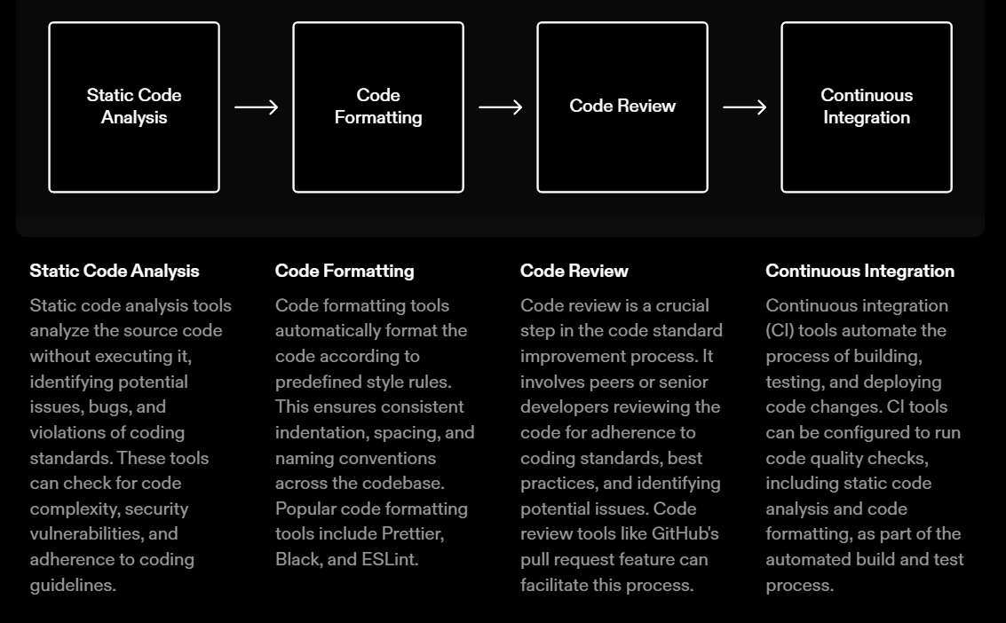
Deliverables

Slide 14
Learning Experience
Technical Skills Enhancement:
Mastery of Code Analysis Tools: We'll gain expertise in utilizing static code analysis tools and integrating them into the development workflow to enforce coding standards effectively.
Understanding Software Development Practices:
Code Standards and Best Practices: Deepening our understanding of coding standards and best practices across various programming languages and frameworks.
Continuous Integration and Deployment: Integrating automated code standards enforcement into CI/CD pipelines will enhance our knowledge of DevOps practices and tools.

Slide 15
Learning Experience
Problem-Solving and Innovation:
Identifying and Addressing Challenges: Overcoming challenges associated with manual enforcement and devising innovative solutions to automate code standards enforcement will hone our problem-solving abilities.
Professional Growth:
Career Advancement: Acquiring expertise in automated code standards enforcement will enhance our professional profiles and open up opportunities for career advancement in software development, quality assurance, or DevOps roles.
Contribution to google research project: If applicable, contributing our solution to the google community will provide visibility, recognition, and opportunities for networking and collaboration.

Slide 16

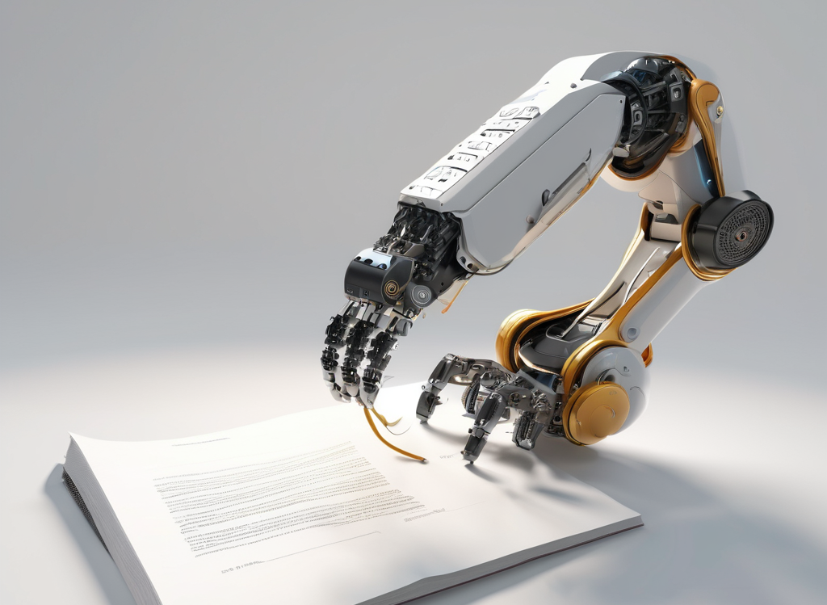

Conclusion
Code standard improvement is crucial for maintaining high-quality software.
Automation can greatly streamline the process of code standard improvement.
By automating code standard improvement, developers can save time and effort, reduce errors, and ensure consistency.
Implementing automated tools and processes can lead to more efficient and effective software development.

Slide 17
References
https://www.codegrip.tech/productivity/using-code-automation-strategy-to-improve-software-development/
https://www.perforce.com/blog/sca/enforce-coding-standards-automated-static-analysis
https://www.codemotion.com/magazine/backend/automation-coding-best-practices/

Slide 18
THANK YOU

